Slide 1
Circulatory System

Slide 2
Curriculum Points
The curriculum points for the circulatory system are all very much interconnected. I am going to list them all at the beginning of the PowerPoint for simplicity and ease of access.

Slide 3
Curriculum Point
The circulatory system is structured to facilitate the transport of materials to and from exchange surfaces, including the lungs, digestive system and kidneys, and the cells of the body

Slide 4
Curriculum Point
The structure of the heart facilitates the efficient flow of blood around the body

Slide 5
Curriculum Point
The blood vessels of the circulatory system have specialised structures that provide for efficient distribution and collection of blood around the body

Slide 6
Curriculum Point
The blood is made up of plasma and several types of blood cells, each with particular functions that aid in the:
transport of materials, including oxygen, nutrients and waste
defence against pathogens

Slide 7
Curriculum Point
The function of the circulatory system can be compromised by cardiovascular diseases that reduce the efficiency of transport of materials around the body

Slide 8
The Circulatory System
The body’s main internal transport system is the circulatory system.
It is the link between the cells inside the body, which have requirements, and the environment outside the body, which supplies those requirements.

Slide 9
Blood
Blood is made up of a liquid part, called the plasma, and a non-liquid part, consisting of cells and cell fragments, which together are called the formed elements.
Plasma makes up about 55% of the blood volume, and the formed elements make up the other 45%.
The formed elements that are suspended in the blood plasma include the red blood cells (erythrocytes), white blood cells (leucocytes), and platelets (thrombocytes).
There is about 4-5 litres of blood in an average adult female and about 5-6 litres in an adult male.

Slide 10
Transport of Oxygen
Oxygen is not very soluble in water, so only about 3% of oxygen is carried in solution in the blood plasma.
The other 97% is carried in combination with haemoglobin molecules that are found only in the red blood cells.
Haemoglobin is able to combine with oxygen to form a compound called oxyhaemoglobin. This is a weak bond as it can break down easily to release the oxygen.
The presence of haemoglobin in the red blood cells increase the oxygen-carrying capacity of the blood by about 60 to 70 times.

Slide 11
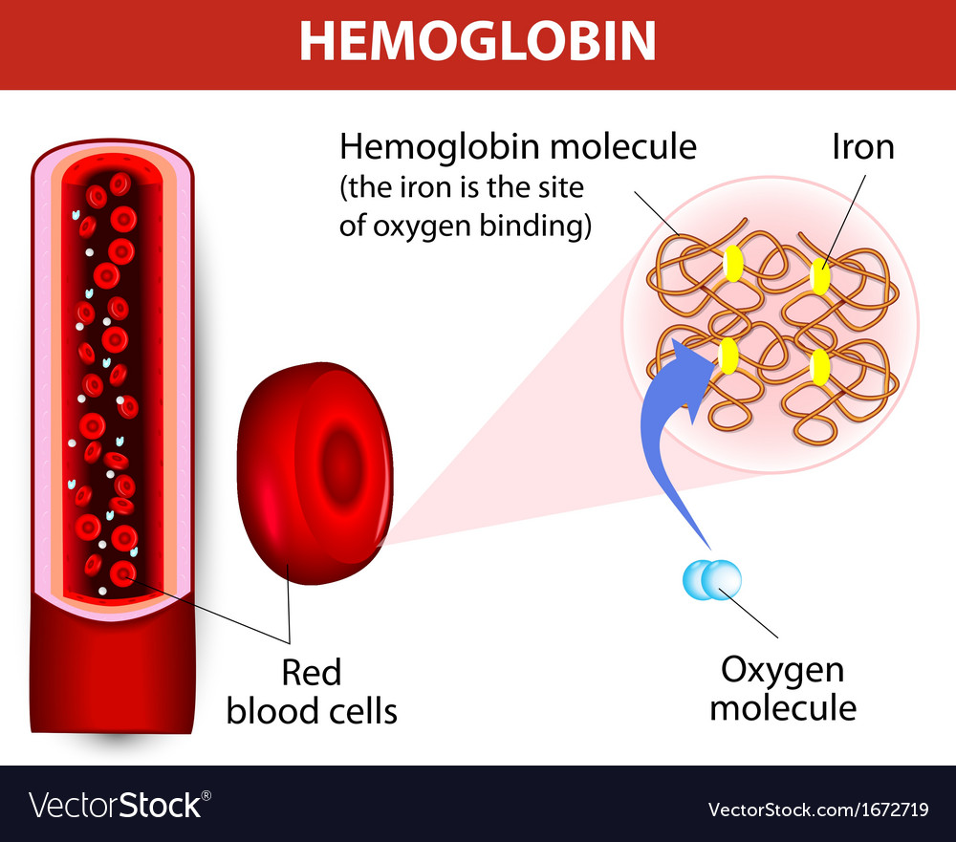

Slide 12
Continued
Oxygen combines with haemoglobin in situations where the oxygen concentration is relatively high. This would occur in the capillaries in the lungs, where oxygen diffuses into the blood from the air in the air sacs.
Oxyhaemoglobin breaks down to haemoglobin and oxygen in situations where the concentrations of oxygen is relatively low.
As the cells of the body continually using oxygen, the tissue fluid around the cells has a relatively low oxygen concentration.
While flowing through the capillaries between the body cells the red blood cells give up their oxygen, which diffuses into the tissue fluid and then into the cells.

Slide 13
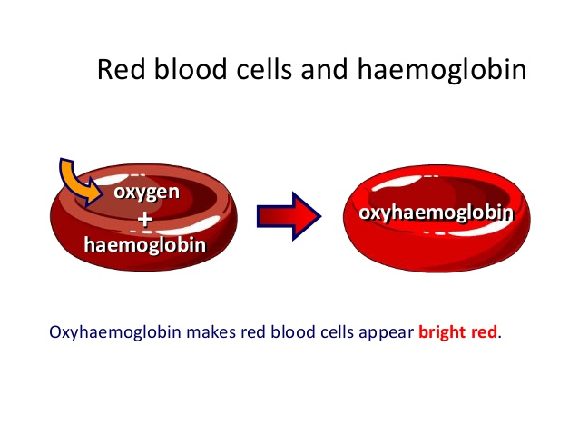

Slide 14
Continued
Oxygenated blood is blood with a high proportion of oxyhaemoglobin.
Oxyhaemoglobin is bright red in colour (why your arteries appear bright red) and haemoglobin is dark red or purplish in colour (why the veins are a blueish colour, as the veins themselves are colourless).
Red blood cells are well suited to their function of oxygen transport because they:
  Contain haemoglobin, which is able to combine with oxygen
  Have no nucleus so that there is more room for haemoglobin molecules
  Are shaped like discs to increase surface area and the thicker edges give a large volume that allows room for the haemoglobin molecules.

Slide 15
Transport of Carbon Dioxide
The carbon dioxide in the blood is carried in a number of different ways. Some (~7%) is dissolved in the plasma and carried in solution. Another ~22% or so combines with the globin part of the haemoglobin molecule to form a compound called carbaminohaemoglobin. The remainder ~70% is carried in plasma.
As blood is flowing through the capillaries between the body cells, carbon dioxide diffuses into the plasma due to the difference in carbon dioxide concentration. Some carbon dioxide dissolves in the plasma, some combines with haemoglobin, but most reacts with water to form carbonic acid.

Slide 16
Continued
The air sacs in the lungs, the alveoli, are surrounded by a dense network of capillaries the reverse occurs. The carbon dioxide dissolved in the plasma diffuses out of the blood into the air in the alveolus.
The carbaminohaemoglobin breaks down, and the carbon dioxide molecules released also diffuse into the alveolus.
Carbonic acid breaks down under enzyme action into water and carbon dioxide. The carbon dioxide also diffuses into the alveolus.

Slide 17
Proportion and location of Oxygen and Carbon Dioxide
Oxygen | Carbon Dioxide
3% dissolved in plasma 97% dissolved in oxyhaemoglobin | 8% dissolved in plasma 22% as carbaminohaemoglobin 70% as bicarbonate ions

Slide 18
Transport of nutrients and waste
Nutrients and wastes are transported and dissolved in the blood plasma.
Nutrients are the essential elements and molecules that are obtained from the food we eat. Inorganic nutrients are transported as ions. Some of the important ions dissolved in the blood plasma are sodium ions, calcium ions, potassium ions, chloride ions, and iodide ions.
Organic nutrients dissolved in the blood plasma include glucose, vitamins, amino acids, fatty acids and glycerol.

Slide 19
Continued.
Wastes, or more correctly, metabolic wastes, are substances produced by the cells that cannot be used and would be harmful if allowed to accumulate.
The most important organic wastes that are transported in solution in the blood plasma are urea, creatinine (waste product from using muscles) and uric acid.

Slide 20
The heart
The heart is the pump that pushes the blood around the body.
It is located in the middle of the chest cavity, between the two lungs.
Roughly conical in shape, the heart is about the size of a closed human fist. Around the heart, and completely enclosing it, is a membrane called the pericardium.
This membrane holds the heart in place but allows the heart to move as it beats.
The pericardium also prevents the heart from overstretching. The wall of the heart itself is made up of a special type of muscle, called cardiac muscle.

Slide 21
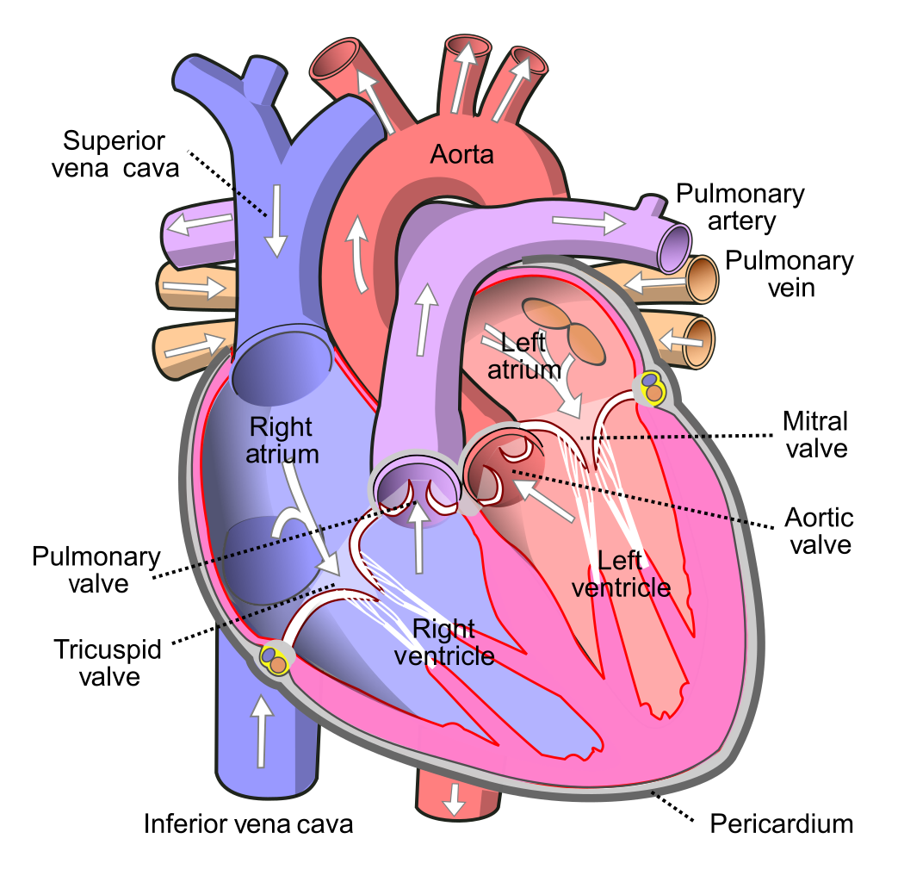

Slide 22
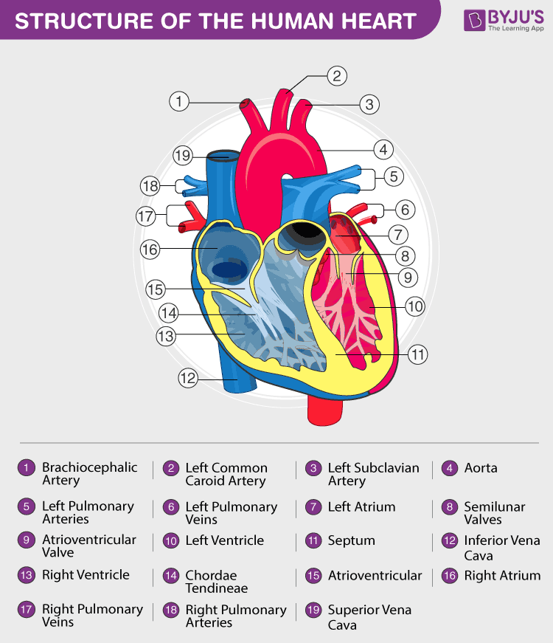

Slide 23
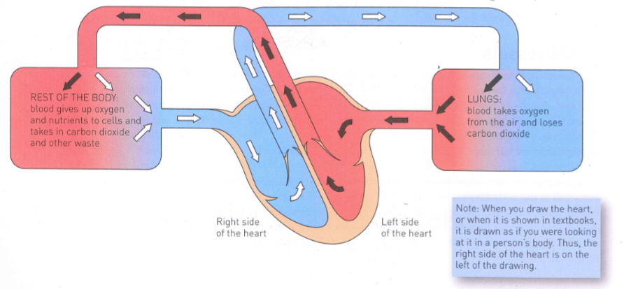

Slide 24
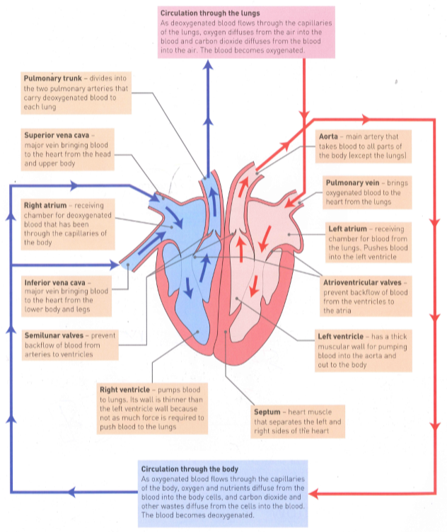

Slide 25
Blood vessels
Blood is pumped by the heart into blood vessels, which carry the blood to the cells of the body or the lungs and then bring it back to the heart again. The same blood floes continuously through the heart, and this movement of blood is referred to as the circulation.
The blood vessels that are joined together to form the channels through which the blood flows are:
  Arteries: which carry blood away from the heart.
  Capillaries: which are tiny vessels that carry blood between the cells.
  Veins: which carry blood back to the heart.

Slide 26
Glue your heart diagram into your book. If you are viewing this online without the work package, I have your heart diagrams in the classroom, which you can collect when school starts back up, leave about half a page to glue it in.

Slide 27
https://www.youtube.com/watch?v=UMTDmP81mG4

Slide 28
Capillaries
Microscopic blood vessels that form a network, carrying blood close to nearly every cell in the body. This enables the cells to get their requirements from the blood and to pass their waste into the blood.
The structure of the capillaries suits them to this function of exchange of materials between the blood and the body cells.
Capillary walls have only one layer of cells.
This allows substances to pass easily between the blood and the surrounding cells.

Slide 29
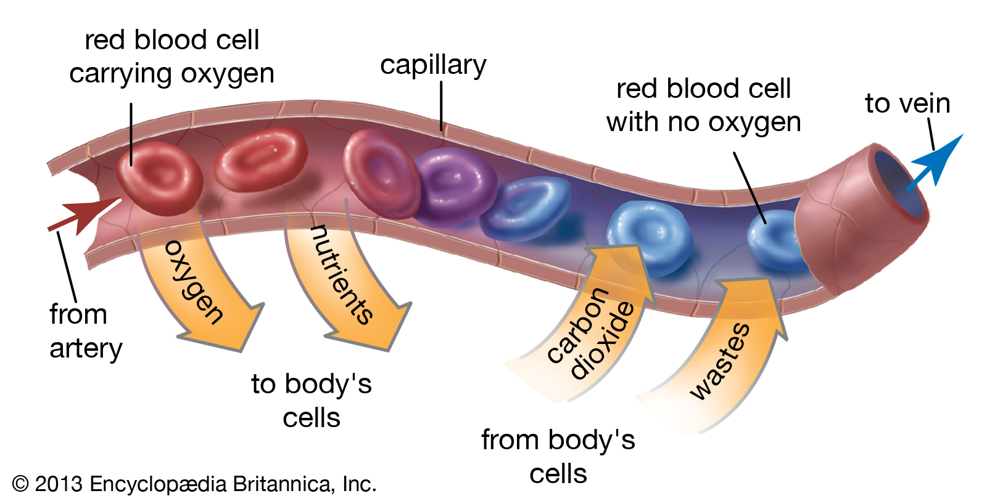

Slide 30
Blood Flow
Blood is the transport medium that delivers oxygen and nutrients to cells and carries away their wastes.
The requirements of cells will vary depending on their level of activity. E.g. when we are actively exercising, the muscles will use up much more oxygen and nutrients, and will produce more carbon dioxide and other wastes, than when we are sitting at rest. To cater for the changes in requirements, the blood flow to and from the cells must be able to change. There are two ways that this can occur: by changing the output of blood from the heart; and by changing the diameter of the blood vessels supplying the tissues.

Slide 31
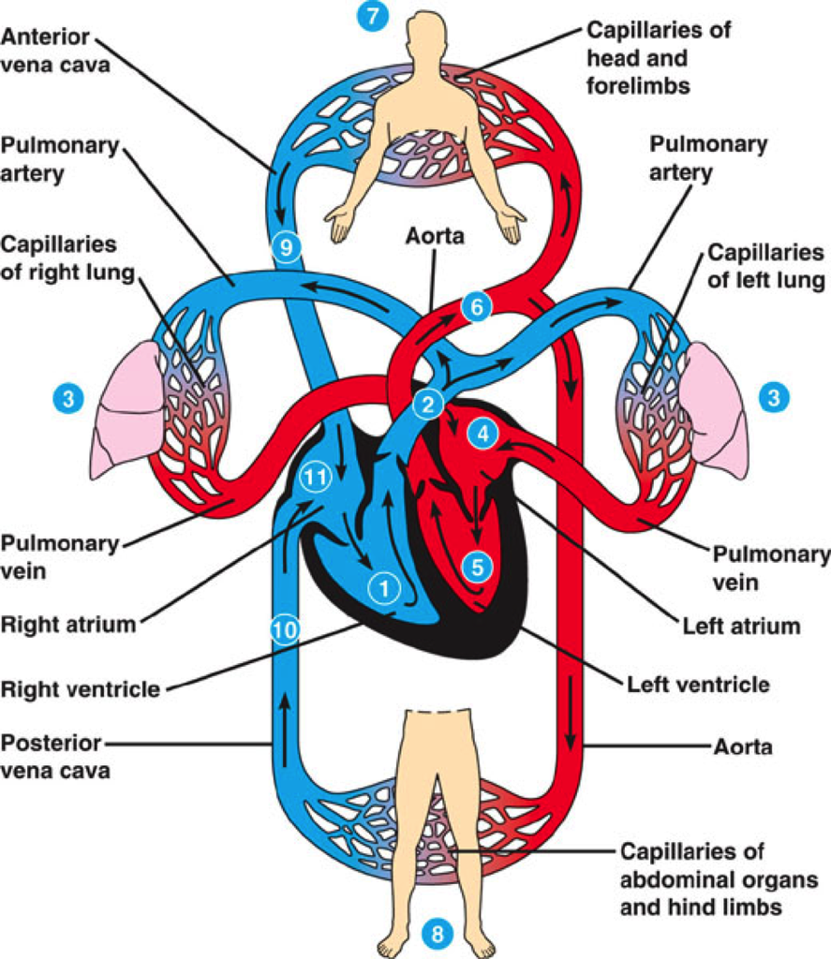

Slide 32
The Cardiac Cycle
The cardiac cycle, or heartbeat, is the sequence of events that occurs in one complete beat of the heart. The pumping phase of the cycle, when the heart muscle contracts is called systole.
The filling phase as the heart muscle relaxes is called diastole.
For a short time both atria and the ventricles also receive blood as the valves between them are open.

Slide 33
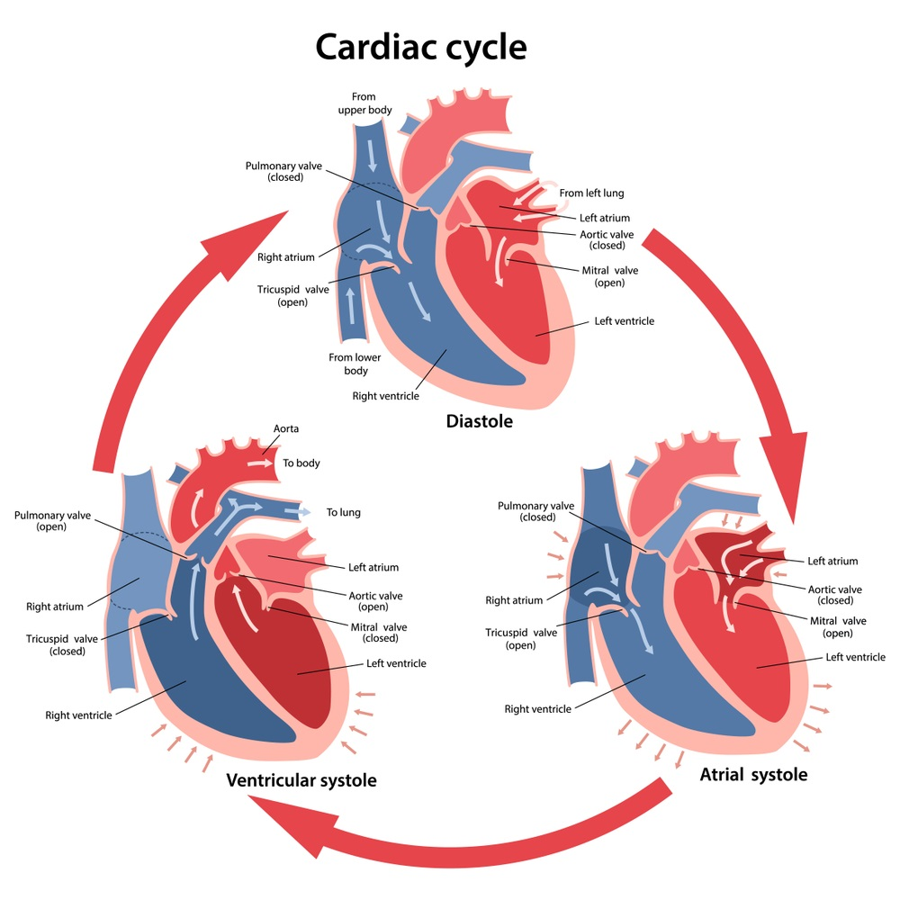

Slide 34
Cardiac Output
The rate of blood flow depends on how fast the heart is beating and how much blood the heart pumps with each beat.
The heart rate is the number of times the heart beats per minute, while the stroke volume is the volume of blood forced from a ventricle of the heart with each contraction.
A combination of both of these factors influences the cardiac output- the amount of blood leaving one of the ventricles every minute. The cardiac output is equal to the stroke volume multiplied by the heart rate.

Slide 35
Blood flow in arteries
Arteries are the blood vessels that carry blood away from the heart.
The walls of an artery contain smooth muscle and elastic fibres. When the ventricles contract and push blood into the arteries, the walls of the arteries stretch to accommodate the extra blood.
When the ventricles relax, the elastic artery walls recoil. This recoil keeps the blood moving and maintains the pressure. The muscle in the artery walls does not contract and relax to pump the blood along.
However, the muscle can contact to reduce the diameter of the artery and thus reduce blood flow to an organ.

Slide 36
Continued.
Such contraction of a blood vessel is called vasoconstriction. Conversely, the muscle may relax to increase blood flow to an organ- vasodilation.
In this way blood flow may be changed from one organ to another to allow for the changing needs of the body.
The very large arteries that receive blood pumped by the ventricles divide into smaller arteries, which supplies blood to the capillaries.
Veins, the blood vessels that carry blood towards the heart, do not have muscular walls and are not able to change their diameter in the way that arteries do.

Slide 37
Arteries | Veins
Carry blood away from the heart | Carry blood towards the heart
Have a blood pressure that increases as the ventricles contract and decreases as the ventricles relax | Have a constant, relatively low blood pressure
Have thick, muscular, elastic walls | Have thin, relatively inelastic walls with little muscle
Have no valves | Often have valves

Slide 38
Regulating cardiac output
The heart has its own inbuilt rhythm of contraction and relaxation, but this can be increased or decreased by nervous stimulation from the cardiac centre in the brain, or by chemical substances.
The sinoatrial node begins each cardiac cycle and acts as a pacemaker.

Slide 39
Regulating blood flow
Blood flow is the amount of blood flowing through an organ or a blood vessel in a given time- usually measured in millilitres per minute.
During exercise, the activity of skeletal muscles is greatly increased to bring about the movement of the body.
To maintain the activity of the muscle cells a large increase in blood flow is required to ensure an adequate supply of oxygen and nutrients, and to remove the carbon dioxide and heat produced.
To ensure that blood supply to the muscles is increased, the nervous system and adrenaline causes constriction of the blood vessels in the internal organs of the stomach and intestines (digestive system).

Slide 40
Working with the Digestive System
The digestive system works very closely with the circulatory system to get the absorbed nutrients distributed through your body. The circulatory system also carries chemical signals from your endocrine system that control the speed of digestion.

Slide 41
Blood flow in veins
Veins carry blood towards the heart. The capillaries join into small veins, (venules), that then join up to male larger veins.
Veins and venules do not have muscular walls and are not able to change their diameter in the way that arteries do.
Blood pressure in the veins is relatively low because the blood loses most of its pressure as it flows through the tiny capillaries.
The walls of veins are therefore much thinner than those of arteries; also, the pressure in veins is constant pressure, many veins have valves to prevent the blood from flowing backwards.

Slide 42
Continued.
As the body exercises, the muscles cells continually require energy.
Respiration in the muscle cells makes the energy available but produces large amounts of wastes, including carbon dioxide and lactic acid.
These wastes act like vasodilators, substances that produce a local widening, or dilation, of arterioles.
This results in increased blood flow through the muscle tissues, ensuring that the cells are functioning.
Cellular respiration also releases a lot of heat energy, which tends to increase blood temperature and an increase in heart rate.

Slide 43
Blood Clotting
When an injury occurs that involves damage to blood vessels, the events that follow help to minimise blood loss from the broken vessels and prevent the entry of infecting micro-organisms.
The muscles in the walls of the small arteries that have been injured or broken constrict immediately to reduce blood flow.
The internal walls of blood vessels are normally very smooth, but any damage creates a rough surface to which the platelets stick.
Sticking platelets attract others, and so a plug is built up at the site of the injury. This plug also helps to reduce blood loss.

Slide 44
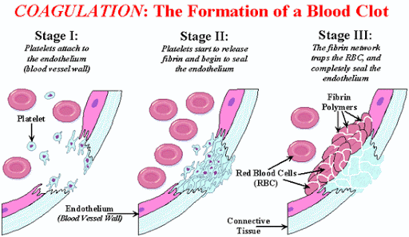

Slide 45
Continued
The platelets release substances that acts as vasoconstrictors, which enhance and prolong the constriction of the damaged vessels.
For many of the small tears that occur in capillaries each day, this plugging action of the platelets and constriction of the blood vessles is sufficient to stop any bleeding.
For more serious injuries blood clotting, or coagulation, is necessary.
The formation series of reactions results in the formation of threads of an insoluble protein called fibrin. The fibrin threads form a mesh that traps blood cells, platelets and plasma.

Slide 46
Continued.
This mesh with its trapped material is the clot. The thread stick to the damaged blood vessels and hold the clot in position.
After the formation of the clot, a slower process known as clot retraction occurs. The network of threads contracts, becoming denser and stronger and pulling the edges of damaged blood vessels together. As clot retraction occurs, a fluid known as serum is squeezed out.
The clot then dries, forming a scab over the wound that prevents entry of infecting micro-organisms.

Slide 47
The Lymphatic System
As blood enters the capillaries, the relatively high pressure forces some of the fluid in the blood through the capillary walls into the tissues.
The main function of the lymphatic system is to collect some of the fluid that escapes from the blood capillaries and return it to the circulatory system.
In addition to this main function, the lymphatic system is an important part of the body’s internal defence against disease-causing organisms.

Slide 48
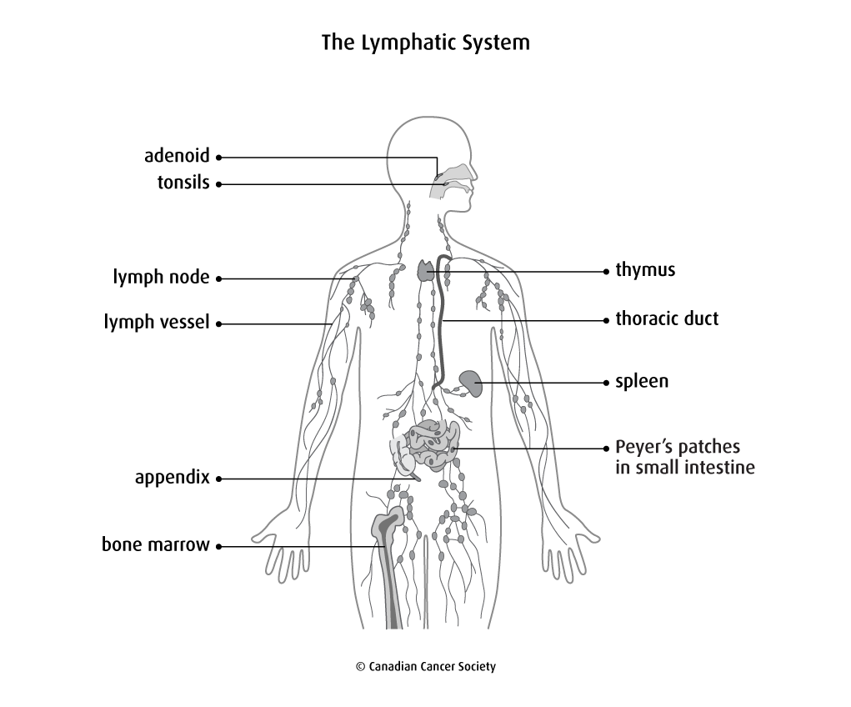

Slide 49
Continued
The lymphatic system consists of:
  A network of lymph capillaries joined to larger lymph vessels
  Lymph nodes, which are located along the length of some lymph vessels.
The lymphatic system destroys micro-organisms.
When infection occurs, the formation of lymphocytes increases and the lymph nodes become swollen and sore.
For example, an infected finger may result in swelling and tenderness in the armpit, where there a large number of lymph nodes.

Slide 50
Blood groups and transfusions
A blood transfusion can be given to a person suffering from excessive blood loss, some types of anaemia, leukaemia, haemophilia or other conditions. It involves blood, or a blood product, from a donor being injected directly into the patient’s bloodstream.
An antigen is a substance that is capable of stimulating the formation of a specific protein called an antibody. Antibodies are produced in response to an antigen and are able to combine with the antigen that initiated the response.
There are two antigens involved in the ABO classification of blood groups: antigen A and antigen B.

Slide 51
Continued.
On the surface of the red blood cells a person may have either antigen A, antigen B, both antigens or neither.
Blood Group | Antigens on red blood cells | Antibodies in plasma | Transfusions
A | Antigen A | Anti-B | A or O blood
B | Antigen B | Anti-A | B or O blood
AB | Both Antigen A and B | Neither Anti-A and Anti-B | All blood types
O | Neither Antigens | Both Anti-A and Anti-B | Can only receive O type blood

Slide 52
Cardiovascular Disease
The heart and blood vessels may be affected by a variety of diseases. These are the cardiovascular diseases, although they are often referred to by the general name of ‘heart disease’.
Cardiovascular disease is at present the most serious health problem in Australian society due to two reasons:
  People in developed countries live longer and cardiovascular disease is more common in older people.
  Changes to physical exercise, diet and other lifestyle choices lead to the decline in heart health and blood vessel problems.

Slide 53
Hypertension
The most common cause of cardiovascular disease is high blood pressure, or hypertension.
Blood pressure fluctuates greatly, depending on the person’s level of activity, body position and emotional state at any particular time.
However, blood pressure that is consistently above the normal level will cause the heart to pump harder, cause damage to the arteries and accelerate the accumulation of fatty deposits in the arteries.
The causes of hypertension are largely unknown. Diet, high salt intake, and consuming excessive amounts of alcohol are all associated with the development of hypertension.
Treatment involves dietary changes to reduce energy and salt intake; regular exercise; regular relaxation and not smoking or drinking will result in a reduction of blood pressure. Drug treatment can be used in cases where hypertension cannot be controlled by other methods.

Slide 54
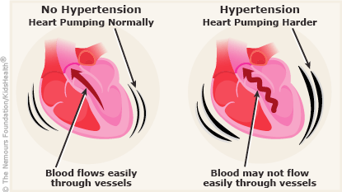

Slide 55
Atherosclerosis
The degeneration of the walls of the arteries, which is commonly known as ‘hardening of the arteries’. It includes such changes as the loss of elasticity of the artery walls, the narrowing of the diameter of the arteries, and the development of any roughness or obstruction of the artery wall.
The roughening and obstruction of the artery wall can lead to a heart attack or stroke.
Atherosclerosis begins with the deposition of fatty substances called plaque. Fibrous tissue develops in those areas, and eventually becomes exposed to the blood. This results in the deposition of calcium salts from the blood. Hard, calcified areas thus develop in the walls of the arteries.

Slide 56
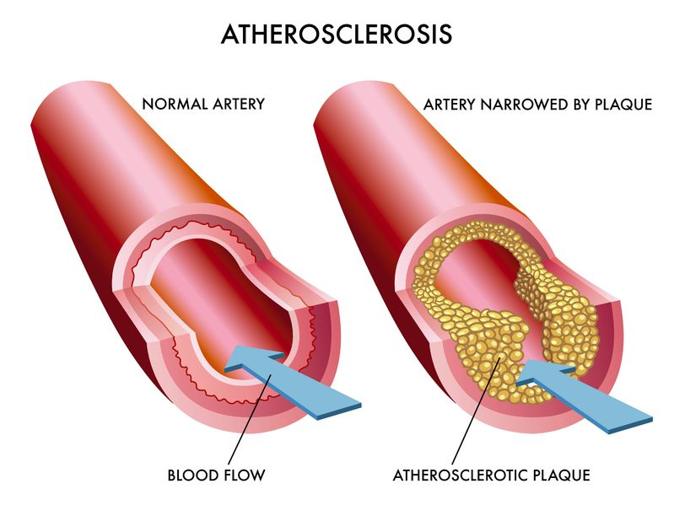

Slide 57
Coronary Heart Disease
The arteries that supply blood to the heart muscle itself are the coronary arteries.
Atherosclerosis of these arteries results in coronary heart disease (or coronary artery disease).
The fatty deposits in the coronary arteries reduce the flow of blood to the heart muscle. This is important during exercise, when blood flow to the heart muscle is usually increased by several times the resting rate of flow.
The presence of obstructing plaques means that the heart muscle supplied by the obstructed blood vessel does not receive enough oxygen to be able to respond to the increased work load during exercise.
Severe atherosclerosis of the coronary arteries may result in angina or heart attack.

Slide 58
Angina
Is pain, or a sensation of heaviness, in the chest.
It may occur during physical activity, or at other times when the heart is called upon to increase output.
The pain usually subsides when the person rests, and there is no damage to the heart muscle.
People with angina can lead relatively normal lives, and drugs can be used to prevent or reduce the pain caused by inadequate blood flow to the heart muscle.

Slide 59
Heart attack
A heart attack occurs when blood flow to a part of the heart muscle is stopped completely. Sometimes this occurs because plaque in the coronary arteries has accumulated to the point where it prevents blood flow through a branch of an artery.
At other times the cause of the blockage may be the formation of a blood clot in an artery already narrowed by atherosclerosis.
The plaque deposits on the inside of the artery can cause a rough surface on which a clot can form.
Whatever the cause, part of the heat muscle is no longer supplied with oxygen, and the muscle in that area dies.

Slide 60
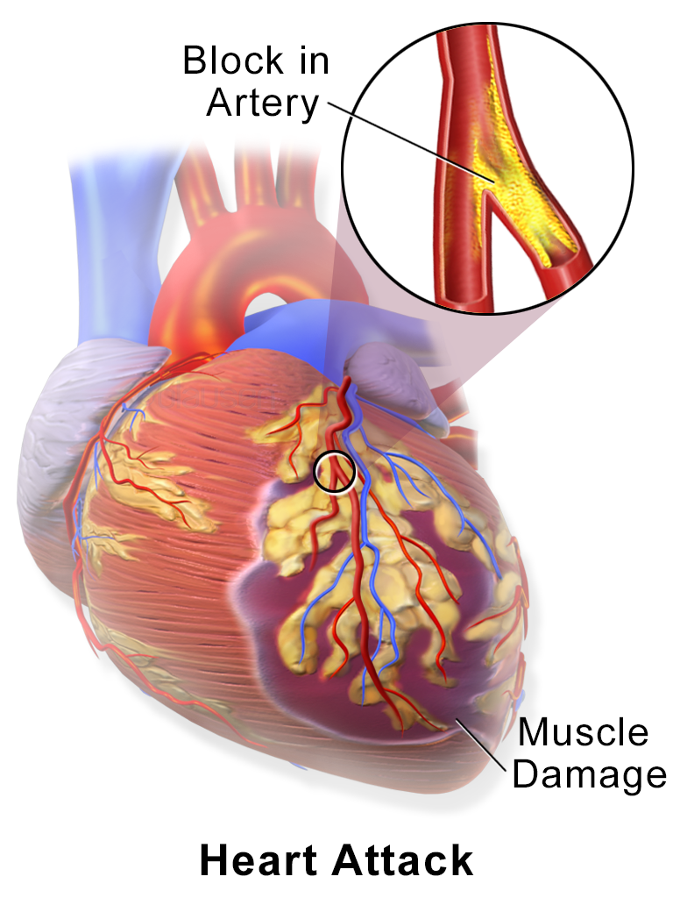

Slide 61
Continued.
This severe injury to the heart, which is accompanied by sudden and severe chest pain, is a ‘heart attack’.
If the area of heart muscle damaged by lack of oxygen is not large, scar tissue forms and new arterial branches develop to supply blood to the area lacking oxygen.
Such healing may occur within a few weeks of a mild heart attack.
If the damage to the heart muscle disturbs the normal rhythmic beat of the heart, cardiac arrest may occur.
The heart pumps little or no blood and may even stop completely. Death occurs within minutes unless normal rhythm can be restored.

Slide 62
Stroke
If atherosclerosis affects the blood vessels supplying the brain, called the cerebral arteries, interruption of the blood supply to a part of the brain may occur. That part of the brain receives insufficient oxygen and the nervous tissue dies.
This is called of a stroke. A stroke may occur if plaque blocks an artery in the brain, if a blood clot forms in an artery that is partly blocked, or if bleeding occurs at a weak point in one of the arteries.
The effect of a stroke depends on which part of the brain is affected by the lack of oxygen. Severe strokes can cause death or severe disability; others are mild and recovery is rapid.
Often strokes can result in paralysis or speech abnormalities.

Slide 63
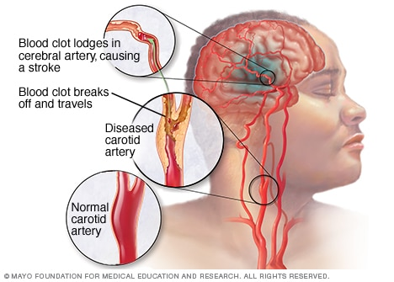

Slide 64
Peripheral Vascular Disease
Cardiovascular disease affecting veins and arteries in the limbs is called peripheral vascular disease.
It usually occurs in the feet and legs, but sometimes affects the hands and arms. Peripheral vascular diseases include:
  Arteriosclerosis in the limb arteries, so that blood supply to part of an arm or leg is slow or absent
  Phlebitis, or inflammation of a vein- such inflammation may cause the development of blood clots.
  Varicose veins- enlarged, lengthened and tortuous veins, which cannot carry blood back to the heart efficiently and may allow blood to accumulate in the lower limbs.
Smoking is a major cause of peripheral vascular disease.

Slide 65
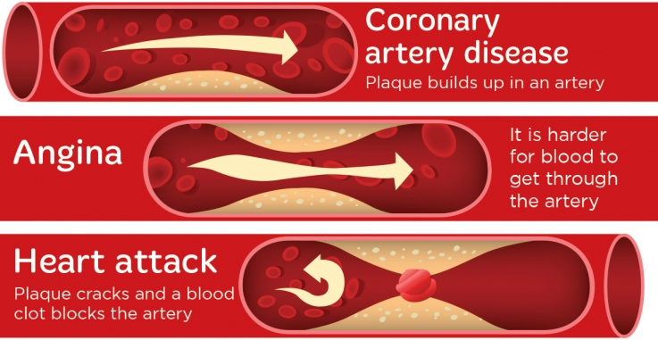

Slide 66
Factors influencing cardiovascular disease
Research have identified many factors that contribute to cardiovascular disease:
  Age: incidence of cardiovascular disease increases with increased age.
  Gender: men develop cardiovascular disease earlier than women.
  Diet: saturated fats and high cholesterol intake increase the chance of cardiovascular disease.
  High blood cholesterol level: increases chance of cardiovascular disease.
  High blood pressure: increases chance of cardiovascular disease.
  Overweight: increases strain on hearts and lungs.
  Smoking: smokers are five times more likely to die of cardiovascular disease than non-smokers.
  Excessive alcohol consumption: associated with hypertension and weakens heart muscle.
  Physical inactivity: increases chance of cardiovascular disease.
  Heredity: tendency for premature death due to heart disease to occur in families.

Slide 67
How to reduce the risk of cardiovascular disease
Do not smoke
Have a healthy diet
Exercise regularly
Maintain a healthy weight
Have regular blood pressure checks
Do not excessively consume alcohol

Slide 68
REVIEW QUESTIONS
These questions are in no particular order. This is to make you go back and review different sections and also to help you connect the smaller dots into a bigger picture.

Slide 69
FOR YOU TO COMPLETE
 | Cause | Description | Treatment
Coronary Heart Disease
Peripheral Vascular Disease

Slide 70
FOR YOU TO COMPLETE
Draw up a table with two columns. In one column list the functions of the blood; in the second, describe the importance of each function to the body.

Slide 71
FOR YOU TO COMPLETE
Describe the ways in which oxygen is carried in the blood?
Describe the ways in which carbon dioxide is carried in the blood?
What is blood flow?
Describe the two ways in which blood flow to an organ can be increased.
What changes occur in blood flow during exercise?
Describe the cardiac cycle.

Slide 72
FOR YOU TO COMPLETE
For each of the following describe how its structure is related to its function:
  Red blood cell
  Artery
  Heart
What is hypertension?
What factors are known to be associated with hypertension?
What is atherosclerosis?

Slide 73
FOR YOU TO COMPLETE
What affects does atherosclerosis have on blood flow?
What is a stroke?
What part of the body is affected by a stroke?
List the factors that contribute to cardiovascular disease.
Why is blood red?
Royalty is sometimes described as having ‘blue blood’. See if you can find out why they have been described in this way.

Slide 74
FOR YOU TO COMPLETE
Cardiovascular disease is sometimes called a ‘lifestyle disease’. Why is this name given to cardiovascular disease?
The heart is a double pump. After passing through the capillaries of the body, the blood returns to the heart to be pumped again before going through the lungs. Explain why the blood must be pumped twice for each complete circulation through the body and lungs.
Why are valves necessary in the heart?
Describe the sequence of events that occur in blood clotting.

Slide 75
FOR YOU TO COMPLETE
What antigens and antibodies are involved in the ABO blood group system?
What determines the ABO blood group to which a person belongs?

